Slide 1
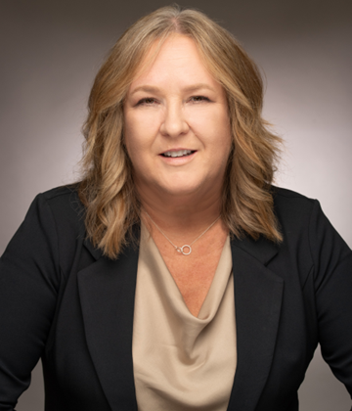
Biography
Jan Price is a Director and Private Banker for Deutsche Bank Wealth Management in the San Francisco Bay Area. Ms. Price brings over 25 years of financial experience to deliver tailored portfolio management to high-net-worth clients. She builds her team of Deutsche Bank experts to assist in specialized lending, wealth management, estate and tax planning with a focus in business succession and liquidity events.
Just prior to joining Deutsche Bank, Ms. Price was leading the US Global Tech team at Citi working with early-stage and fast growth technology, media and telecom companies. She has assisted businesses in all industry verticals over the past decade strategizing to meet their domestic and international growth goals by advising on credit structure, treasury management and foreign exchange. Her lending background has included a real estate portfolio of multi-family, office, construction and owner-occupied buildings.
Previously, Ms. Price led teams to high performance in the retail bank after being a premier banker herself where she focused on financial solutions for a select portfolio.
Ms. Price has an Accounting degree from Diablo Valley College, has extensive commercial credit training, and FINRA Series licenses SIE, 63, and 7. She has been active in non-profits such as Stand for Families Free of Violence, North Idaho Violence Prevention and Impact 100 East Bay.
Ms. Price can be reached at 415-725-8039 or emailed at jan.price@db.com.
Jan Price
Director,
Relationship Manager
054850 050525

